Slide 1

Agentic AI Hackathon: Building Intelligent Agents with IBM Granite and LangFlow
TEAM SSS

Slide 2
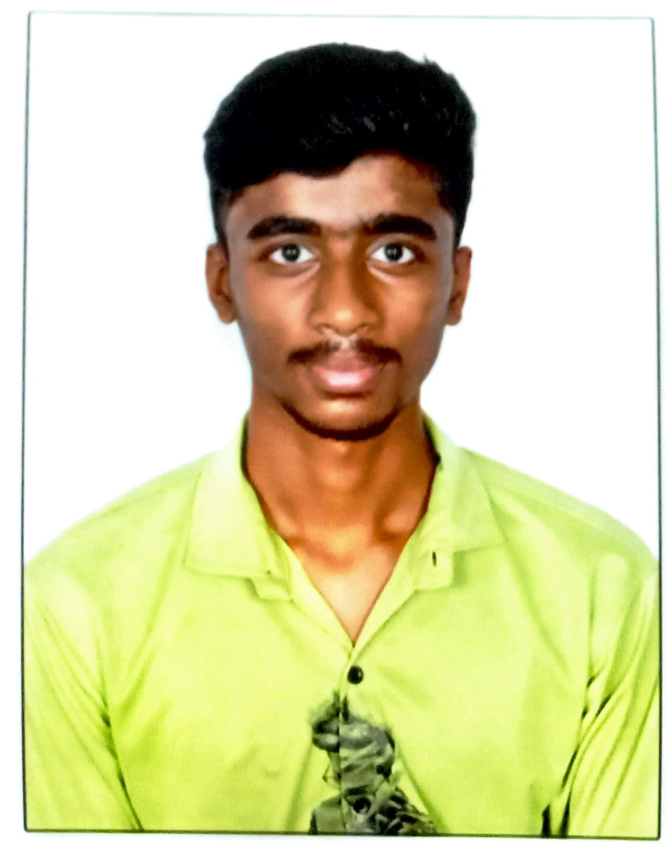


Details of Team members
TEAM MEMBER NAME | Recent Passport Photo | Email ID | Phone number [WhatsApp]
LOHITH J |  | lohithjayarama@gmail.com | +91 99804 10357
MAHESH N |  | mahesh.mnraj@gmail.com | +91 91480 47775
KISHOR V S |  | kishor1kishor112004@gmail.com | +91 72598 36195

Slide 3
Problem Statement
Problem Statement 8: AI-Assisted Medication Adherence Monitoring System
The Challenge
Medication non-adherence is a major challenge in chronic disease management, as patients often struggle with:
Inconsistent intake – forgetting doses or skipping medications due to complex schedules.
Refill gaps – running out of prescriptions without timely renewals.
Behavioral barriers – side effect concerns, forgetfulness, or lifestyle conflicts.
Lack of monitoring – no continuous visibility into adherence patterns for healthcare providers.
Without an intelligent AI assistant, providers miss declining trends, leading to poor health outcomes, increased hospitalizations, and $529B annual costs globally.

Slide 4
Proposed Solution
An AI‑Assisted Medication Adherence Monitoring System built using LangFlow and IBM watsonx.ai.
Collects structured patient data including medication intake logs and refill history.
Uses three specialized AI agents to:
1. Analyze medication information
2. Detect adherence risks
3. Provide short, educational reminders
Integrates RAG (Search API + URL blocks) to ensure accurate, trusted educational insights.
Generates clear, concise, non‑repetitive outputs for patient awareness.

Slide 5
Need of Project
Medication non‑adherence is a major challenge in chronic disease management.
Missed doses often go unnoticed until health conditions worsen.
Healthcare providers lack continuous visibility into daily medication intake.
Patients and caregivers need simple, understandable adherence feedback.
There is a need for an assistive, non‑diagnostic AI system to improve awareness and consistency.

Slide 6
End User of Project
Patients with chronic diseases who take long‑term medications.
Caregivers managing medication routines for elderly or dependent patients.
Healthcare providers for adherence awareness (non‑clinical use).
Hospitals & clinics for patient education support systems.
Health‑tech platforms integrating adherence monitoring tools

Slide 7
Technology Used
Langflow Platform
Langflow components name
IBM Watson.ai,
Agent(3),
Chat input ,
Chat output,
Search.ai and
URL
IBM Grainte model – ibm/granite-3-8b-instruct
IBM Cloud
RAG – Search.ai and URL
Watsonx

Slide 8
Novelty and Uniqueness
Uses a multi‑agent AI architecture, each agent with a focused responsibility.
Strictly assistive and non‑diagnostic, ensuring ethical AI usage.
Short, structured, and patient‑friendly outputs — no long explanations.
RAG‑enabled responses using real medication adherence best‑practice resources.
UI generates ready‑to‑use structured input for LangFlow without manual formatting.
Prevents hallucination and repetition through strict agent separation.

Slide 9
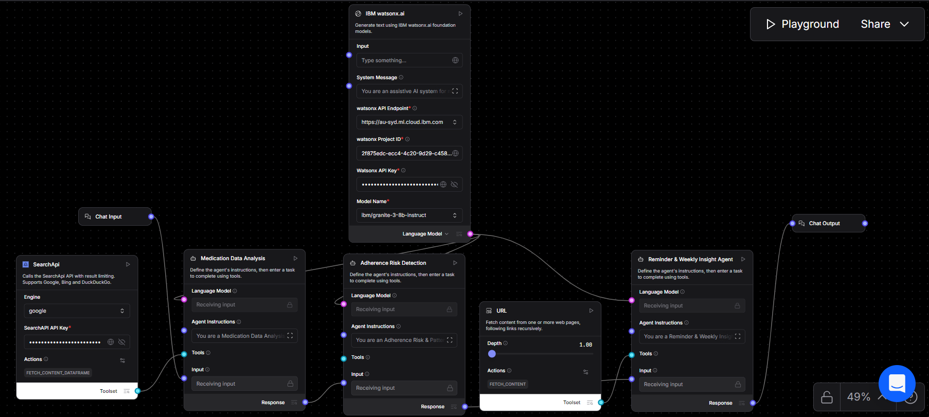
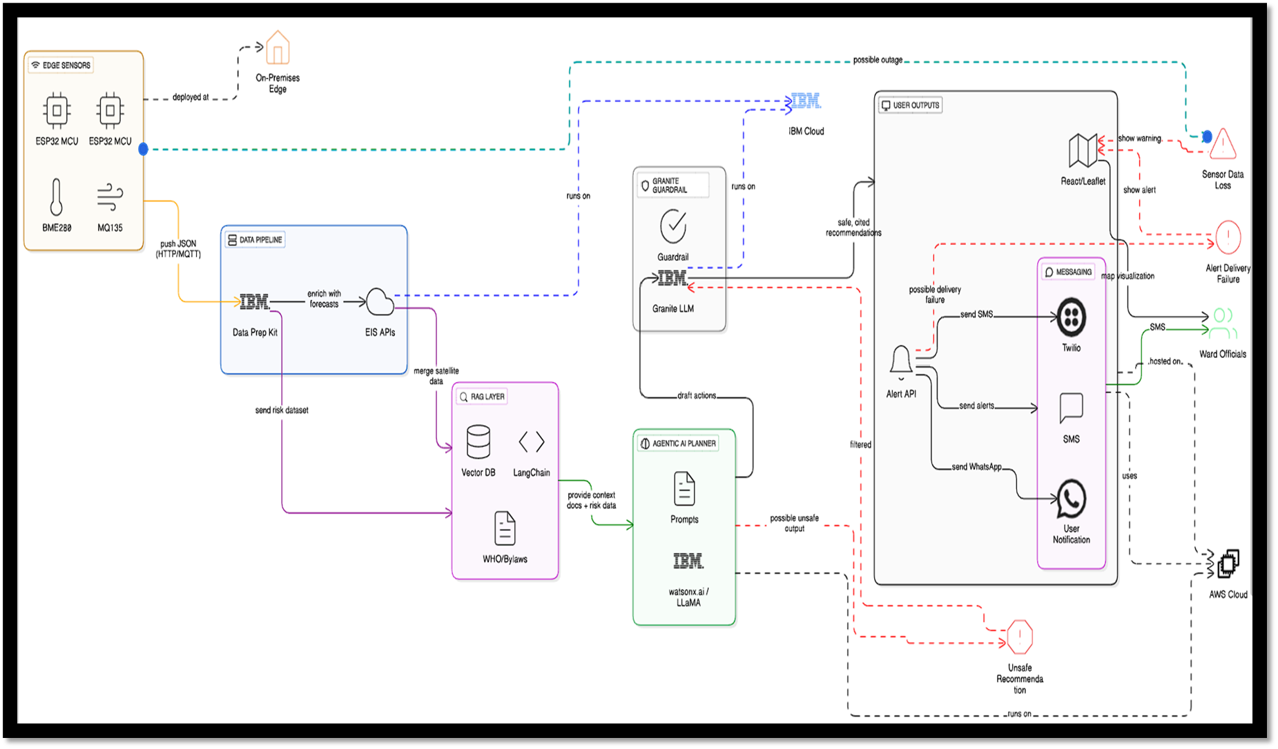
Architecture Blueprint

Slide 10
Langflow Components Used
Chat Input Block
Accepts structured patient and medication data generated from the UI.
IBM watsonx.ai (Granite Model) Block
Acts as the core language model for all agents.
Generates safe, assistive, and non‑diagnostic outputs.
System Message Block
Defines global rules such as non‑repetition, short responses, and ethical constraints.
Agent 1 – Medication Data Analysis Agent
Analyzes each medicine and explains its general purpose.
Agent 2 – Adherence Risk Detection Agent
Identifies missed‑dose patterns and assigns adherence risk levels.
Agent 3 – Reminder & Weekly Insight Agent
Generates short reminders and educational insights per medicine.
Search API Block
Retrieves medication adherence best‑practice information for RAG.
Ensures factual and up‑to‑date educational content.
URL Loader Block
Fetches trusted healthcare and patient education resources.
Supports accurate weekly educational insights.
Output / Chat Output Block
Displays final structured results for the end user.

Slide 11
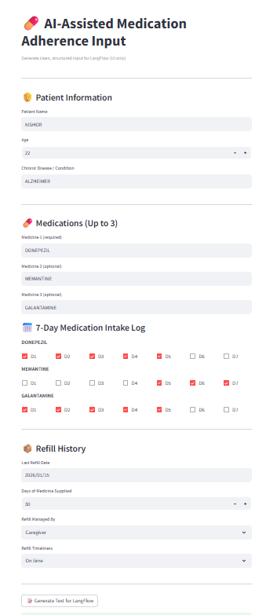
User Interface

Slide 12
System Date (Today): 02-Feb-2026
Patient Profile:
Patient Name: KISHOR
Age: 22
Chronic Condition: ALZHEIMER
Refill History:
Last Refill Date: 15-Jan-2026
Days of Supply: 30
Refill Managed By: Caregiver
Refill Timeliness: On time
Medication Intake Log (7 Days):
DONEPEZIL:
Day 1: Taken
Day 2: Taken
Day 3: Taken
Day 4: Taken
Day 5: Taken
Day 6: Missed
Day 7: Missed
MEMANTINE:
Day 1: Missed
Day 2: Missed
Day 3: Missed
Day 4: Missed
Day 5: Taken
Day 6: Taken
Day 7: Taken
GALANTAMINE:
Day 1: Taken
Day 2: Taken
Day 3: Taken
Day 4: Taken
Day 5: Taken
Day 6: Missed
Day 7: Missed
Input Extracted by UI

Slide 13
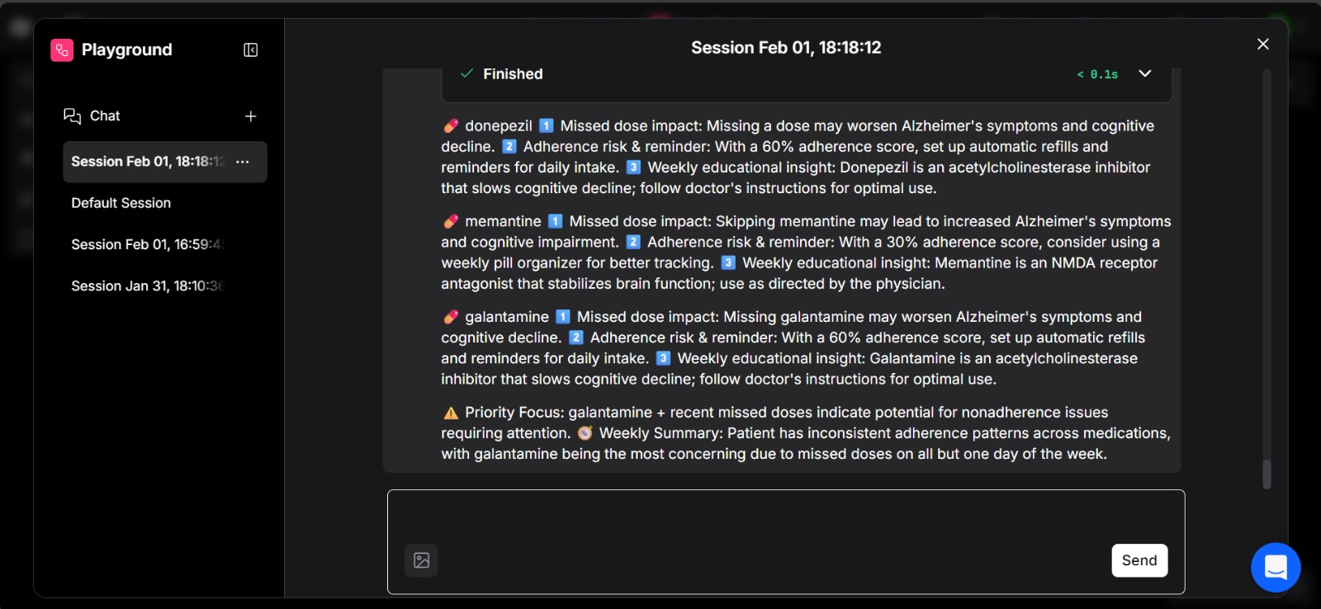
Output

Slide 14
Future Scope
Integration with wearables and mobile health apps for real‑time adherence tracking.
Support for multilingual outputs to reach diverse patient groups.
Trend analysis over longer periods (monthly / quarterly adherence).
Personalized reminder strategies based on patient behavior.
Dashboard views for caregivers and healthcare organizations.
Integration with EHR systems (educational insights only).

Slide 15
Git Hub Link
https://github.com/lohithj29/MedMonitor

Slide 16


